Slide 1

Covid-19 machine learning
Federico Ariton Sba22090
Higher Diploma in Science in Data Analytics for Business

Slide 2
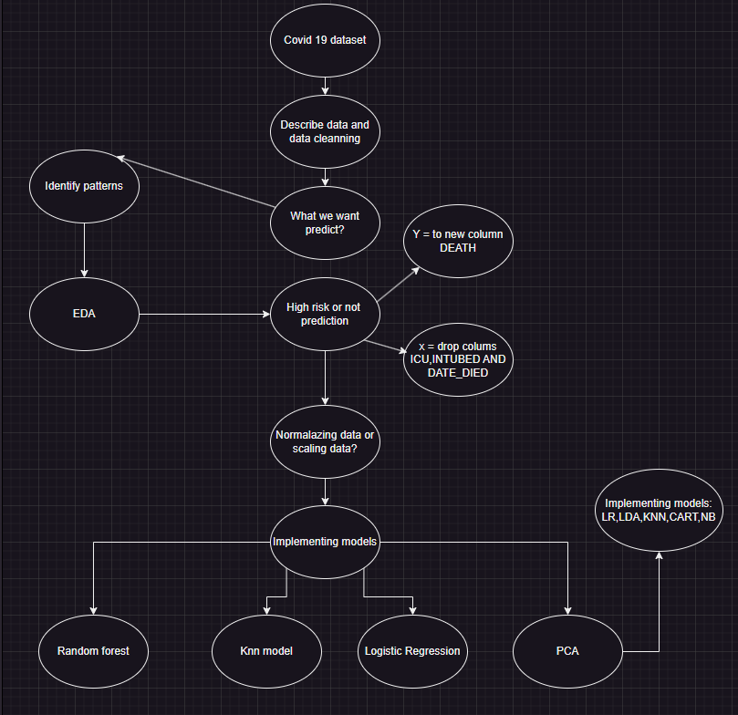
Project Objective
The primary objective of this project is to develop a machine learning model. This model aims to assess the risk level of COVID-19 patients by analyzing their symptoms, current health status, and medical history. Such a predictive tool could be vital in making informed decisions about resource allocation and patient care during the pandemic.
The image illustrates the structured layout of our project, detailing a step-by-step organizational approach. This schematic has been instrumental in guiding the restructuring process, clearly delineating each phase for easier follow-through. The visualization highlights the project's potential, showcasing how systematic planning and decision-making can enhance its development.
This revised version offers a clearer, more concise description.It emphasizes the importance of the schematic in the project’s restructuring process and its role in revealing the project's potential.

Slide 3
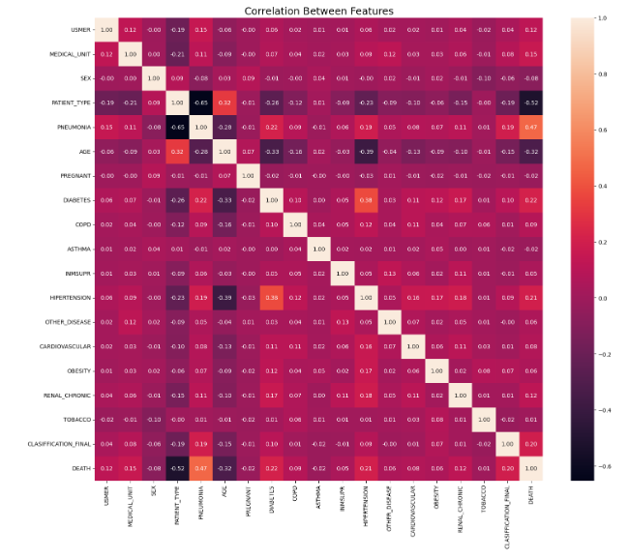
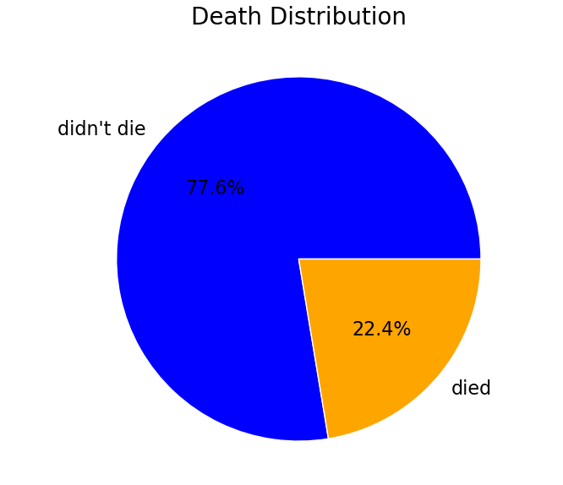
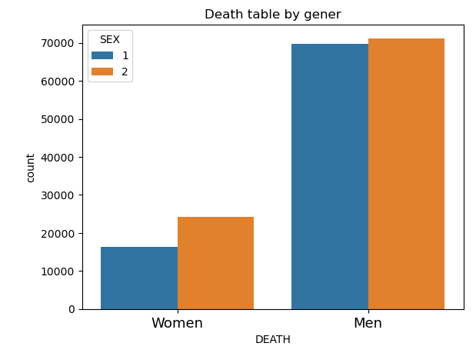
EDA
EDA to understand the dataset deeply. This includes visualizing the distribution of COVID-19 cases with outcomes such as deaths and gender. Use plots like histograms, pie charts, and correlation matrix to visualize the proportion of death and survivals. This visualization helps in identifying patterns or anomalies in the dataset.

Slide 4
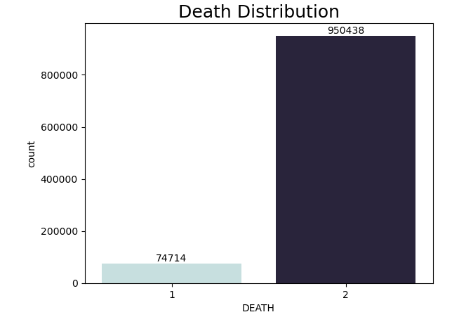
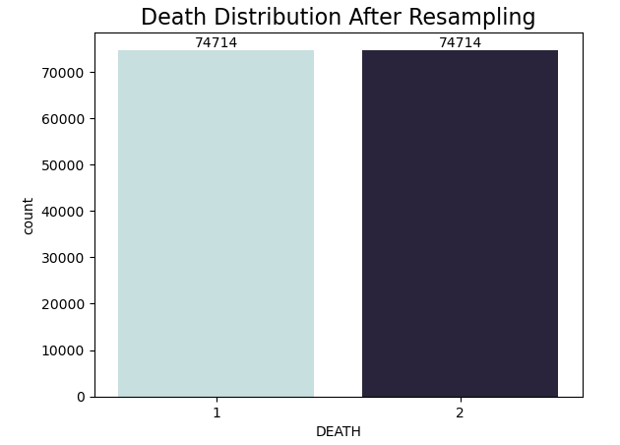
Sampling the data
After reviewing the Exploratory Data Analysis (EDA), we pointed 'death' as the critical variable (y) for predicting whether a COVID-19 patient is at high risk.
There is, an imbalance in the data where there are more deaths than survivals which could bias our model to predict 'did not die' more frequently.
To address this, we will implement resampling techniques to balance our dataset, ensuring that our predictive model isn't skewed by the disproportionate class sizes. This step is crucial for enhancing the model's ability to accurately predict high-risk patients.

Slide 5
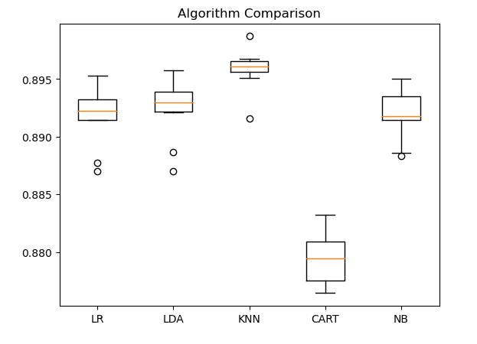
Implementation of models and PCA
After implementing several models to determine the best fit for our data, based on accuracy metrics, we observed the following results:
Logistic Regression emerged as the top-performing model, achieving the highest accuracy at 91%. This suggests it could be a highly suitable choice for our dataset.
The Random Forest model followed closely, with an accuracy of 90%.
The K-Nearest Neighbors (KNN) model showed an accuracy of 87%.
Similarly, the Gaussian Naive Bayes (GaussianNB) model also recorded an accuracy of 87%.
PCA
We conducted a Principal Component Analysis (PCA) for dimensionality reduction and subsequently tested various models to ascertain the most effective one. Our findings reveal that Logistic Regression (LR) and Linear Discriminant Analysis (LDA) both displayed higher median accuracies, coupled with relatively narrow interquartile ranges. This indicates a consistent performance across different iterations of the models. The K-Nearest Neighbors (KNN) model also showed a commendable level of consistency, although with a marginally lower median accuracy. In contrast, the Classification and Regression Trees (CART) model exhibited more variability in its performance. Notably, the Naive Bayes (NB) algorithm demonstrated the broadest range in accuracy scores, which suggests it is the least consistent among the evaluated models.

Slide 6
Conclusion
After the EDA revealed a significant pattern in the 'death' variable, for predicting high-risk COVID-19 patient and handling with missing value and the imbalanced data, with a higher number of survivals compared to deaths, could potentially lead to a predictive bias towards survival outcomes.
The use of various models and metrics provides a thorough understanding of each model's performance, guiding the selection of the most appropriate model for the given dataset.
These steps are very important for developing reliable predictive tools in public health, particularly for managing and anticipating the needs of high-risk COVID-19 patients.

